Slide 1

Induction Training

Slide 2

Programme for the day
Welcome & Introductions
The AA role
Administration & House keeping
Next steps/Q & A

Slide 3
SAAVS
WELCOME TO THE SURREY APPROPRIATE ADULT VOLUNTEER SERVICE
The Surrey Appropriate Adult Volunteer Service offers support to vulnerable adults and young people who find themselves detained in Police custody.
The role of the Appropriate Adult is not to provide legal advice but to offer impartial support and be a friendly face in the absence of a family member or carer, to people who may be feeling frightened, bewildered, and confused in an unfamiliar situation.

Slide 4
About SAAVS
The use of AAs was enshrined in law in 1984.
SAAVS was established in 1995.
SAAVS - offers a professional service in a friendly manner. We don’t advise on legal matters and we aren’t Social Workers. We focus on the needs of the detained person. We aim to be in Custody within an hour
Monthly statistics: August: 44 VA’s & 48 CYP’s

Slide 5
Purpose – to protect the interests of the young person or vulnerable adult
Ensure the DP (Detained Person) understands why they are in Custody
Ensure that the DP understands their Rights and Entitlements and the Caution
Safeguard their interests by helping them to communicate
Facilitate access to food, water, shower, exercise, sanitary products
Request a solicitor on behalf on DP
Interact with the Police, Solicitor, Health Care Professional & LDS
Encourage the DP to engage with offers of support
Report safeguarding concerns to the Custody Sergeant

Slide 6
The AA must prioritise the person’s rights and welfare, even if that means challenging police decisions and
AA’s should feel confident to:
Challenge grounds for detention.
Check understanding of Rights and Entitlements at every stage as these are ongoing. If the DP does not understand their Rights and Entitlements at any point, then fitness for interview should be challenged.
Ask for a delay in interviewing the DP if necessary. For example, you are concerned for their mental and emotional state.
Step in in an interview if you feel that the DP is being led/coerced/manipulated or pressured in any way.
Challenge the language being used for CYP’s.

Slide 7
Mental Health Act (MHA) assessments
When a MHA assessment is awaited, and if the police want to interview a person before the assessment, in summary you should:
Check which law the person is held under
Get a lawyer actively involved
Advocate for health matters to be prioritised (as also being in the interests of justice)
Focus on the PACE questions: are they fit to be detained and to be interviewed?
Do not attend interview unless you are confident the person is fit to interview
Document your actions and objections clearly on the custody record and in interview
For more information please see the Mental Health Act (MHA) assessments section on iKAAN

Slide 8
Receiving a call Crib Sheet and information needed
Which custody suite
Vulnerable adult or child/young person
Nature of the alleged offence
Has a solicitor been called and expected time of their arrival
Details of the DP, including name and age
Call reference number

Slide 9
Arriving in Custody and Custody records
Read thoroughly, make notes and then return to sergeant for shredding prior to leaving. UNDER NO CIRCUMSTANCES SHOULD CUSTODY RECORDS BE REMOVED FROM CUSTODY.
It is your responsibility to check that your personal telephone number is not recorded on the CR, if it is there, please notify the Custody Staff. The only number for SAAVS should be 01483 974252. Be prepared to ask questions and challenge points in the record e.g. Have they had anything to eat? Have they seen a Health Care Professional? Fingerprints – some things can happen before you arrive as the DP may not have been thought as vulnerable.
Take your time to acquaint yourself with the record before you meet with the DP, even if the detectives are ready to question them. Fingerprints and photos and DNA can take place after the interview
DP’s can be rearrested for other offences once in Custody and these will need to be recorded on the PACE report form.

Slide 10
Custody - Care and treatment of DPs
Custody is all about the welfare of the DP. At this point things have only been alleged.
DPs have the right to read the Code of Practice. Some do ask, few read it!
Ensure the DP has appropriate food and drink. They are likely to be held for some hours.
They cannot smoke but the HCP may offer a nicotine lozenge.
They may be offered time in the exercise yard.
They are entitled to a shower.
Females should have been offered sanitary protection and is often asked by a female officer or health professional. The DP may not wish to discuss it with a male.
Young DPs will be given rest periods. Don’t feel you have to stay.
Engage the DP in conversation – general chit chat, remember don’t discuss the case.

Slide 11
Right to be held incommunicado and legal advice
DPs may be able to make a phone call but the person they nominate could be a victim or a potential suspect. If more than one person has been arrested there is potential for sharing of information so contact will be temporarily denied.
Frequently DPs will say they don’t want a solicitor because they think they will be released more quickly, or they think they are innocent. Solicitors are free whilst in custody and should always be consulted. AA’s do not give any legal advice.

Slide 12
DP and Solicitors
It is SAAVS policy to request that a solicitor attends for all DP’s. It is a legal requirement for any child under 18.
Disclosure is given to the solicitor/legal rep
DP’s will have a private & confidential meeting with their solicitor prior to interview
AA’s do not normally attend a solicitor’s meeting with the DP – we do not have Legal Privilege

Slide 13
Meeting with the Detained Person (DP) 1
Introduce yourself, stating that you are a SAAVS volunteer and that you do not work for the police. Ask how they would like to be addressed. Let them know that you are there to support them through the process and make sure they understand what is happening. Be calm and impartial.
Ask how they are. If they take medication, it will be on the Custody Record, it is worth asking them when they last had their medication. Have they had food and a drink, arrange more if necessary. Hot/cold drinks, meals, biscuits & cereal bars are available for DP’s.
All appropriate adults develop their own style and technique according to their own personality. Flexibility of approach is required because DPs are infinitely variable.
Teamwork – HCP, LDS, Solicitors, SAAVS, Police (email presentations)

Slide 14
Meeting with the Detained Person (DP) 2
Explain the process, R & E’s, Fingerprints, Photograph etc.
Explain that the solicitor will give them advice, however they do have a choice as to whether they choose to accept the advice given – it is their choice.
Explain what happens in interview, caution, room layout, introductions etc…
During calm and quiet conversation, you can elicit the DP’s circumstances.
The Custody Sergeant & LDS will offer information about supportive organisations, encourage (when appropriate) the DP to accept this support.
Report any safeguarding or other concerns to the Custody Sergeant – these will be recorded on the custody record and taken forward and notified to the office either by telephone or email. You will also need to notify the office as soon as possible. (Email link)

Slide 15
Caution
“You do not have to say anything, but it may harm your defence if you do not mention when questioned something you later rely on in court. Anything you do say may be given in evidence”.29 Mar 2016
You do not have to say anything – DPs can give a no comment interview or remain completely silent, but it may harm your defence if you do not mention when questioned something you later rely on in court – police will refer to “negative inferences”. If it needs to be explained more carefully. Ask the officer to break it down further.
Anything you do say may be given in evidence – hence solicitors and legal reps advising no comment interviews. It is the job of the police to find the evidence to convict.

Slide 16
Interview 1
Everyone in the room will be asked to introduce themselves, this will include explaining your role – you are there for the wellbeing of the DP and to help facilitate communication.
The interview will begin with the caution. It is essential that the DP understands it. If in doubt, make your concerns known. The interview should not proceed if there are concerns that the DP does not understand.
The solicitor will have advised how to respond to questions. There are three choices: A no comment/silent interview; answer the questions; or submit a prepared statement which is prepared and read by the solicitor.

Slide 17
Interview 2
The interview can include statements, photos, video footage, transcripts of text messages etc…
If at any time you find what you see or hear disturbing and you need to step away from the case. Inform the custody staff that you need to leave and contact the office.
Sometimes Officers will repeatedly ask the same questions. Solicitors sometimes intervene. DPs have the right not to answer.
If the DP is becoming tired/confused/upset or the interview has been running for a long time, the AA or solicitor can request a break.

Slide 18
After Interview: with Officers
DP’s can sometimes be concerned about how they will get home. After the interview is a good time to raise this with the officers.
When the interview has concluded the DP should still not discuss the case with you.
The Emergency Duty Team (EDT) would have been notified that CYP has been detained in custody. Should there be a need for alternative accommodation may be sought.

Slide 19
After Interview: DP Charging and Disposal
Decisions regarding what will happen to the DP can sometimes be made by the Custody Sergeant if not, Detectives may need time to gather evidence and sometimes the decision is with the CPS.
Depending on who makes the decision on charging, this can be made by the Custody Sargeant, Detectives or the CPS will determine how long the wait will be.
Sometimes a decision can be made relatively quickly but if the case is sent to the CPS it can be several hours before a charging decision is reached.
AAs need to be at the disposal, but it doesn’t have to be the same AA if you are no longer on duty.
The officers will ensure the DP has somewhere to stay and appropriate transport home. Under no circumstances are you to offer to transport the DP

Slide 20
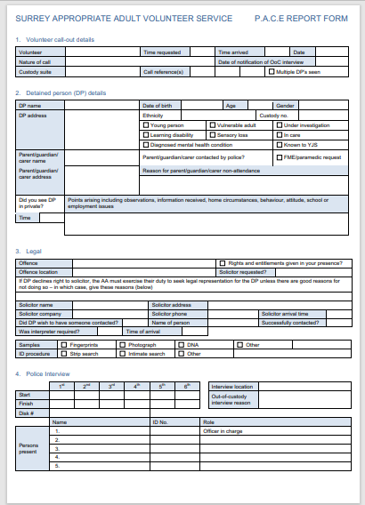
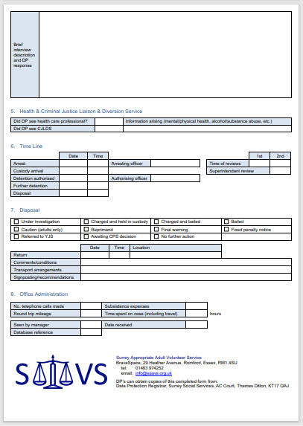
Pace Report Form

Slide 21
Administration
Photograph
Training – Bridge visits, mentoring calls etc.
Roster : Owning a slot
Communication – contact numbers/email addresses
Commitment to training events & Reps Meetings Next steps & thank you

