Slide 1

CHECKPOINT
DATA QUALITY
You are reminded that:
It is your personal responsibility to ensure the accuracy, relevance and timeliness of all data entered by you onto Surrey Police Systems

Slide 2
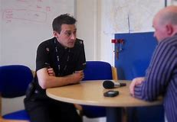
LESSON AIM
To provide an understanding of the Checkpoint process within Custody

Slide 3
LESSON OBJECTIVES
Explain what Checkpoint and Checkpoint Plus is
Outline the eligibility criteria for Checkpoint and Checkpoint Plus
Have an understanding of the process to be undertaken during release from custody

Slide 4
What is CHECKPOINT?
Surrey Checkpoint is a process whereby the decision to prosecute or issue an out of court disposal is deferred pending completion of checkpoint contract which will include conditions to target reasons for offending and the needs of the victim
The program aims to reduce the number of victims of crime by reducing offending
Surrey Checkpoint offers eligible offenders the opportunity to engage in this deferred prosecution scheme for lower level offences
The eligibility criteria for the scheme will be similar to the YRI and WJI schemes with some minor differences which will be explained later
Checkpoint will now include male detainees who meet the criteria
Checkpoint will replace the WJI scheme.

Slide 5
Why is Checkpoint being introduced in Surrey?
Surrey Checkpoint is a scheme based on Durham Constabulary’s existing checkpoint scheme but with some local adaptations.
The Scheme has been chosen by Surrey because interim results from an external evaluation by Cambridge University have shown a reduction in re-arrest of 11 per cent and proven reoffending reduction of 9.7 per cent.
Existing schemes in Surrey (Youth Restorative Intervention and Womens Justice Intervention) has proven a great success which as produced an 18 per cent reduction in reoffending and victim satisfaction of over 80 per cent.

Slide 6
CHECKPOINT PLUS
Surrey will include a Checkpoint Plus element to the scheme
Checkpoint Plus will include offenders with multiple disadvantage (see next slide)
This cohort of offenders will have an enhanced eligibility criteria including accepting offenders with numerous previous convictions
The cohort will initially consist of women offenders, women domestic abuse offenders and care leavers but the plan is to increase this cohort in the future
Checkpoint Plus will initially only be open to female detainees and male or female care leavers
Care leavers are those that the SCS has statutory responsibility for (they will self-declare that they are care leavers and it is anticipated that the numbers will be low).

Slide 7
MULTIPLE DISADVANTAGE
Examples of Multiple Disadvantage includes but is not limited to:
Homelessness
Alcohol abuse
Drug Abuse
Subject to Domestic Abuse
Known to the Criminal Justice System

Slide 8
Checkpoint and Checkpoint Plus – Eligibility
Offended in Surrey
Live in Surrey
18 or over
Has not had a Checkpoint disposal in the past 12 months
Not be subject to an order imposed by the courts. (Exemptions for non like offences authorised by an Insp. Not civil orders such as DVPN)
Admissions – The subject has to admit the offence. (offenders must be interviewed except Sec 5 POA and D&D)
The Crown Prosecution Service charging guidelines must be met:
There must be sufficient evidence to charge and;
Be in the public interest to do so
Have committed an offence which is eligible for an out of court disposal
No more than 3 Previous convictions (men only)

Slide 9
Checkpoint Plus – Additional Eligibility
The eligibility criteria is widened for offenders with multiple disadvantage:
The restrictions on number of previous convictions is removed
The restriction on only one Checkpoint outcome in 12 months is removed
These cases will go before a multiagency panel who can also use Conditional Cautions or decide to send back to the officer for a charging decision
No conditional cautions can be given for DA.

Slide 10
CHECKPOINT – DOES NOT INCLUDE:
For males, DA Offences (women are still eligible for Checkpoint in relation to DA offences)
Indictable only offences
Motoring offences
Breach of the Peace, immigration offences and bail offences will not be considered (list not exhaustive)
Eligibility is determined on the disposal offence and not the arrested offence.
Out of Force (including BTP) detainees
Hate Crime

Slide 11
CHECKPOINT – INCLUDED OFFENCES
Arson (no aggravating factors)
Assault ABH
Assault Police / Assault on Emergency Workers
Assault-Common Assault without injury
Burglary in a building other than a residential home (no violence)
Criminal Damage (less than £5000)
Criminal Damage-Threat or Possession with intent to commit
Cruelty to or Neglect of children (SIU consulted)
DA offences for female offenders
Drugs – Possession. Production cultivation of cannabis
Drunk & Disorderly
Drunk & Incapable
Fraud or Forgery (less than £5000)
Found on Enclosed Premises
Going Equipped
Handling Stolen Goods
Harassment (no link to DA except women)
Making Off Without Payment
Malicious communications (no DA except women)
Possession of knife, bladed article and Offensive Weapon
Public Order section 3,4,5
Theft offences Shoplifting, TFMV, TOMV, Theft from Person, Bike Theft, Vehicle Interference, Other

Slide 12
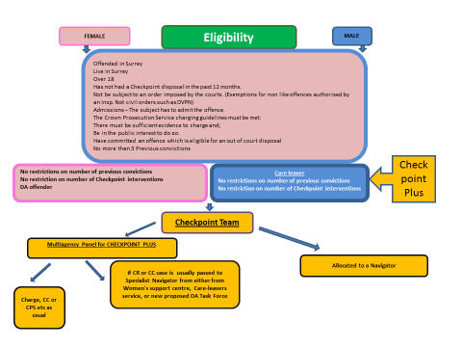
CHECKPOINT FLOW CHART

Slide 13
Delivery of the Checkpoint Scheme
The Schemes interventions will be a mixture of those delivered by a Navigator and local providers
Navigators will be trained in restorative justice as well as other interventions
Navigators will be trained officers or specialists from the following services:
Police
Women’s Support Centre
Care Leavers Team
Mental Health Services
Partner agencies including other statutory authorities
Local charities
Offender Pays schemes
Engagement of partner agencies and being able to refer offenders to statutory and third sector support is crucial to the scheme’s success.

Slide 14

Offender Pays Scheme : Druglink

Slide 15
Checkpoint Governance
Will come from the Criminal Justice Board through the Transforming Justice Program Board then through strategic and operational meetings.

Slide 16
Out of Court Disposals
Surrey Police will be streamlining its out of court disposals in line with the new National Charging and Out of Court Disposals Strategy.
The aim is to move from the current 6 out of court disposals down to two for adult offenders.

Slide 17
Streamlining Out of Court Disposals
Adult Simple Cautions will only be retained under certain circumstances (e.g. where CPS have authorised such a disposal OR DP lives out of Surrey)
Conditional Cautions will be utilized a lot more – unlikely to be issued in Custody
Cannabis Warnings and PNDs will no longer be an option for disposal in custody.
Surrey Police main disposals through Checkpoint will now be Community Resolutions and Conditional Cautions
In custody The disposal on Niche will be Checkpoint Intervention - Referral

Slide 18
Strategic Principals behind the changes
Victims are at the heart of decision making, are listened to and understood, are informed of action taken and their views are recorded
Out of court disposals have conditions attached to them which seek to address underlying offending behaviour through rehabilitative conditions and/or enable swift reparation to victims and communities
Systems are simple, streamlined and make the best use of technology
Decisions are made and obtained in a timely manner
Decisions are transparent, and involve independent and public scrutiny
Innovation is encouraged to reduce harm caused by reoffending
An evidence base is developed and maintained to assess what works, and this is easily accessible to all parts of the Criminal Justice System
People experiencing multiple disadvantage will often have repeat contact with the criminal justice system and require better coordinated interventions, such as Checkpoint, to break the cycle of offending.

Slide 19
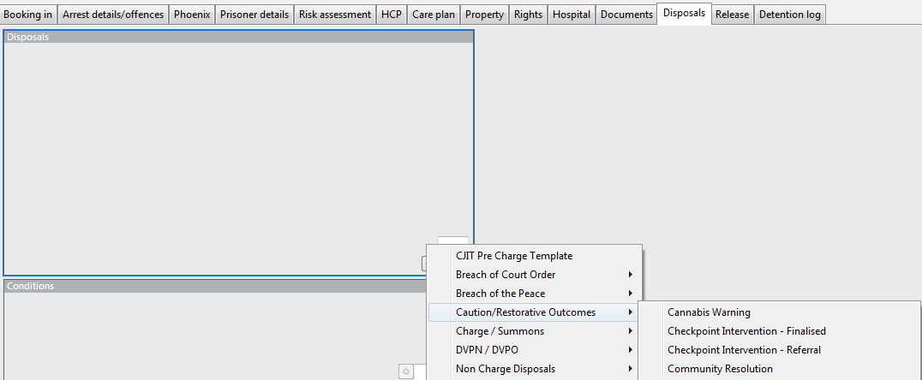
NICHE – Disposal Screens
Notes:
TRAINER NOTES
Trainer to explain that until an upgrade to NICHE occurs, the RA will be taken directly from the Custody Risk Assessment of NICHE and placed as an additional Risk Assessment Tab on the VA Niche Record.
Trainer to go through each of the questions that appear in the risk assessment.
NOTE: Complete RA section (at the top of the Risk Assessment) will always be set to YES in VA
There will be Help Fields for each question by clicking on the Question Mark to guide officers if required.

Slide 20
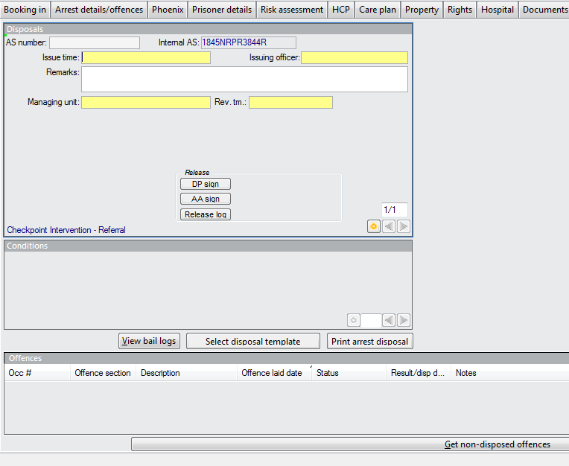
NICHE – Disposal Template
Set Review time for 3 months in the future
Notes:
TRAINER NOTES
This section of the Risk Assessment MUST be completed
Trainer to explain that there will be times when a VA attendee refuses or just does not answer the questions honestly.
The Observations of the Interviewing Officer are, therefore, of paramount importance and must be recorded on the VA Record.
It should be pointed out that Risk is an ongoing assessment throughout the VA Process.

Slide 21
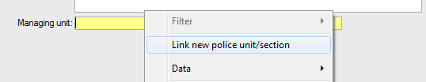
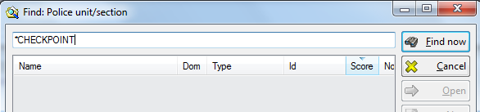
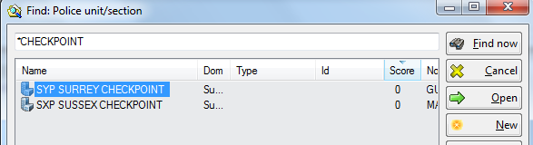
Niche – Managing Unit Selection

Slide 22
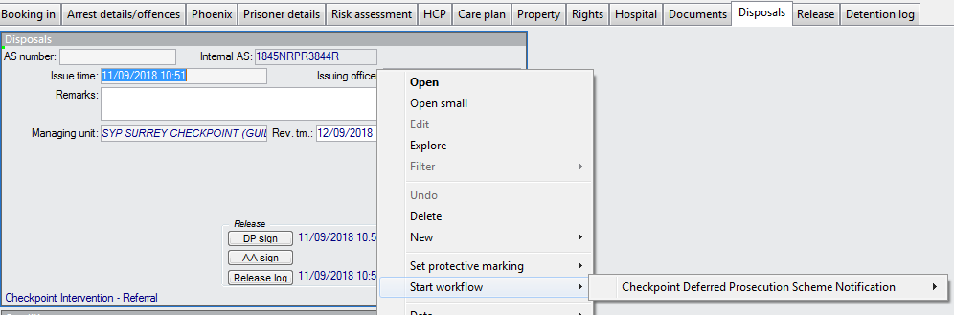
Niche – Create workflow

Slide 23
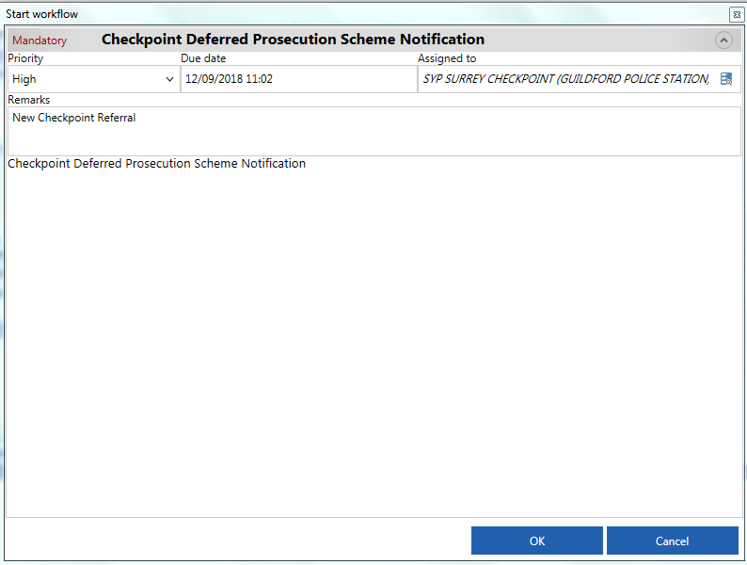
Workflow Template

Slide 24
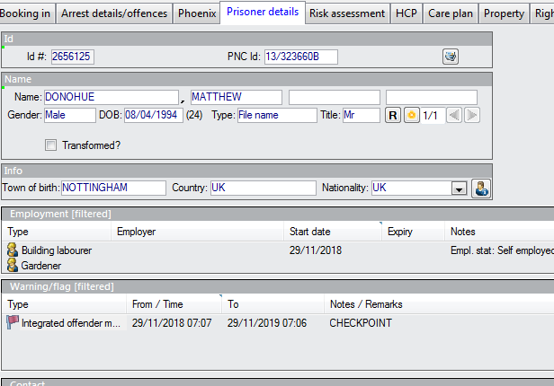
Checkpoint Flag on Niche
A Checkpoint Flag will be created by the Checkpoint Team once the process has been finalised
Custody Sergeants will need to check the Warnings on the Person record to ensure that there is no Checkpoint flag in place. If there is the person WILL NOT be eligible for Checkpoint

Slide 25
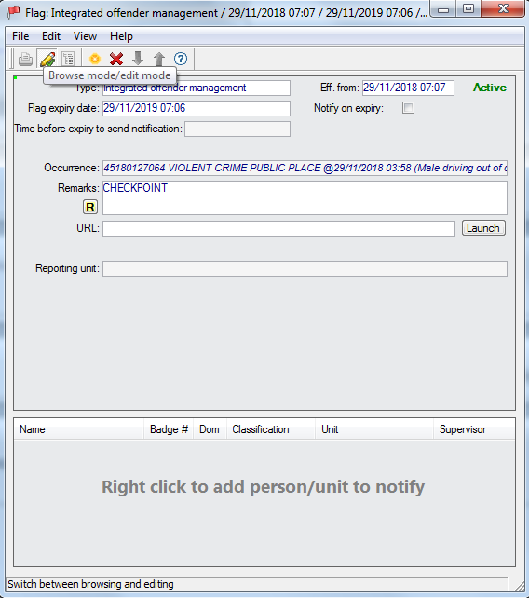
Checkpoint Flag
Type : IOM
Eff From : Date of Checkpoint Referral
Flag Expiry Date: 12 months from date of referral
Remarks : CHECKPOINT

Slide 26

ANY QUESTIONS?

